Slide 1
Group 10 - 貝殼 BackSpace
A Dedicated Space & Resource Reservation System for NPC.
112810006 李圓凱
113590017 黃楷程
113590037 黃閔陽
113590042 陳佑軒
Notes:
Good afternoon, everyone. We are Group 10. Today, we are excited to present our final project: BackSpace. This is a dedicated space and resource reservation system designed specifically for the needs of student clubs and labs here at NTUT.

Slide 2
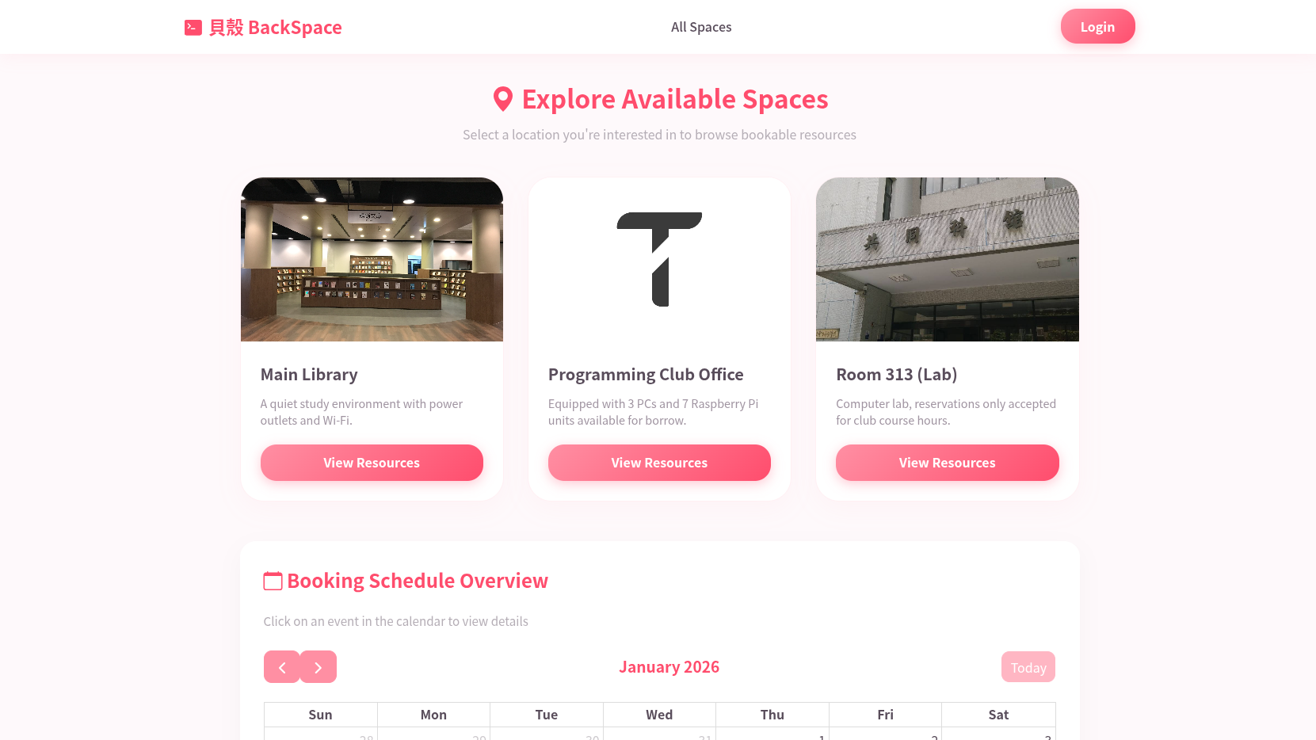

Slide 3
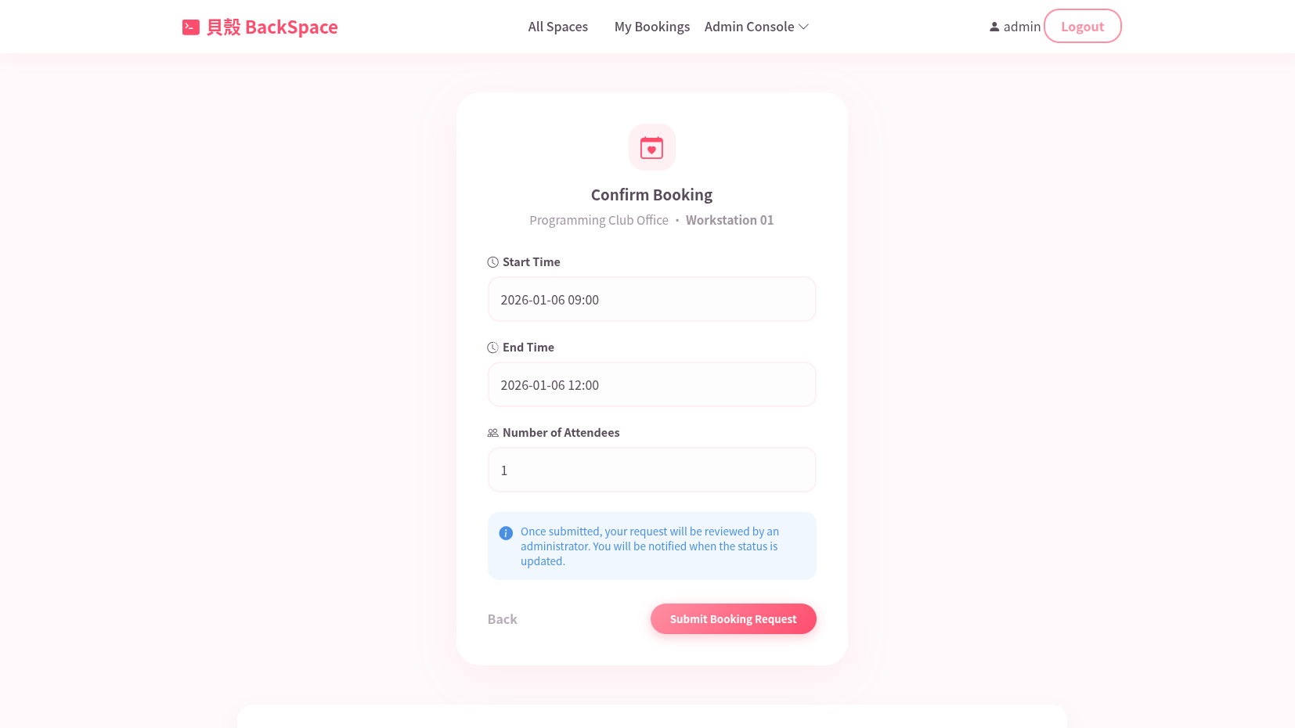

Slide 4
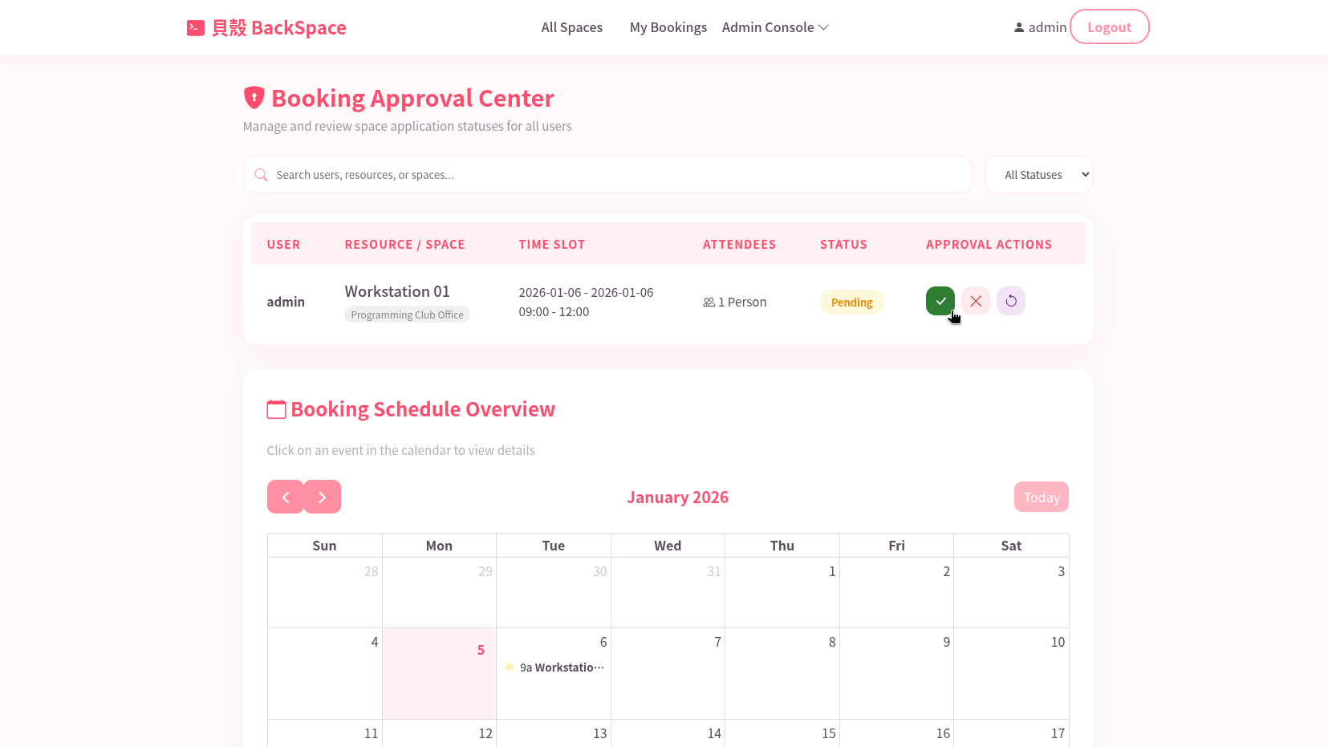

Slide 5
Motivation
The Problem:
Current club space booking relies on paper forms or verbal agreements.
Students cannot see real-time availability.
Double-booking occurs frequently.
The Solution:
A centralized Web Platform for real-time status checks and reservations.
Digitalizes the workflow:
Apply -> Review -> Approve
Notes:
So, why did we build this? We noticed a major problem with how clubs currently book spaces. First, many still rely on paper forms or verbal agreements, which is inefficient. Second, there is a lack of transparency—students can't see real-time availability. And worst of all, double-booking happens frequently, leading to conflicts. Our solution is a centralized Web Platform. We digitized the entire workflow: Apply, Review, and Approve, all in one place.

Slide 6
Features
Visual Discovery:
Browse spaces (Club rooms, Labs) via a card-based UI.
Real-time Availability:
"Calendar View" shows booked slots instantly to prevent conflicts.
Asset Management:
Reserve specific equipment (e.g., Computers, Recording gear) within a room.
Admin Dashboard:
A dedicated portal for managing requests (Approve/Reject) and editing space details.
Notes:
Let's look at our core features:
Visual Discovery: We use a card-based UI so users can easily browse rooms and labs.
Real-time Availability: This is crucial. Our 'Calendar View' shows booked slots instantly to prevent those conflicts I mentioned.
Asset Management: We go beyond just rooms. You can reserve specific equipment, like a specific computer or recording gear.
Admin Dashboard: A dedicated portal for club leaders to approve or reject requests easily.

Slide 7
Tech Stack
Frontend:
HTML
CSS
JavaScript
Bootstrp Icons
FullCalendar
Deployment:
Host: Ubuntu 24.04 LTS
Containerization: Docker (Database)
Web Server: Caddy
DNS/Security: Cloudflare
Backend:
Python Flask
Database:
PostgreSQL (Docker)
Notes:
Technically, we wanted to build something production-ready, not just a localhost demo.
Frontend: We used and FullCalendar and Bootstrap Icons for the interface.
Backend: We built it on Python Flask.
Database: We chose PostgreSQL running in Docker.
Deployment: The system is hosted on an Ubuntu server, using Caddy as a web server and protected by Cloudflare for DNS and security.

Slide 8
Live Demo
https://final.ntut.uk
Notes:
Our system is currently live. A can visit final.ntut.uk to check it out yourself.

Slide 9
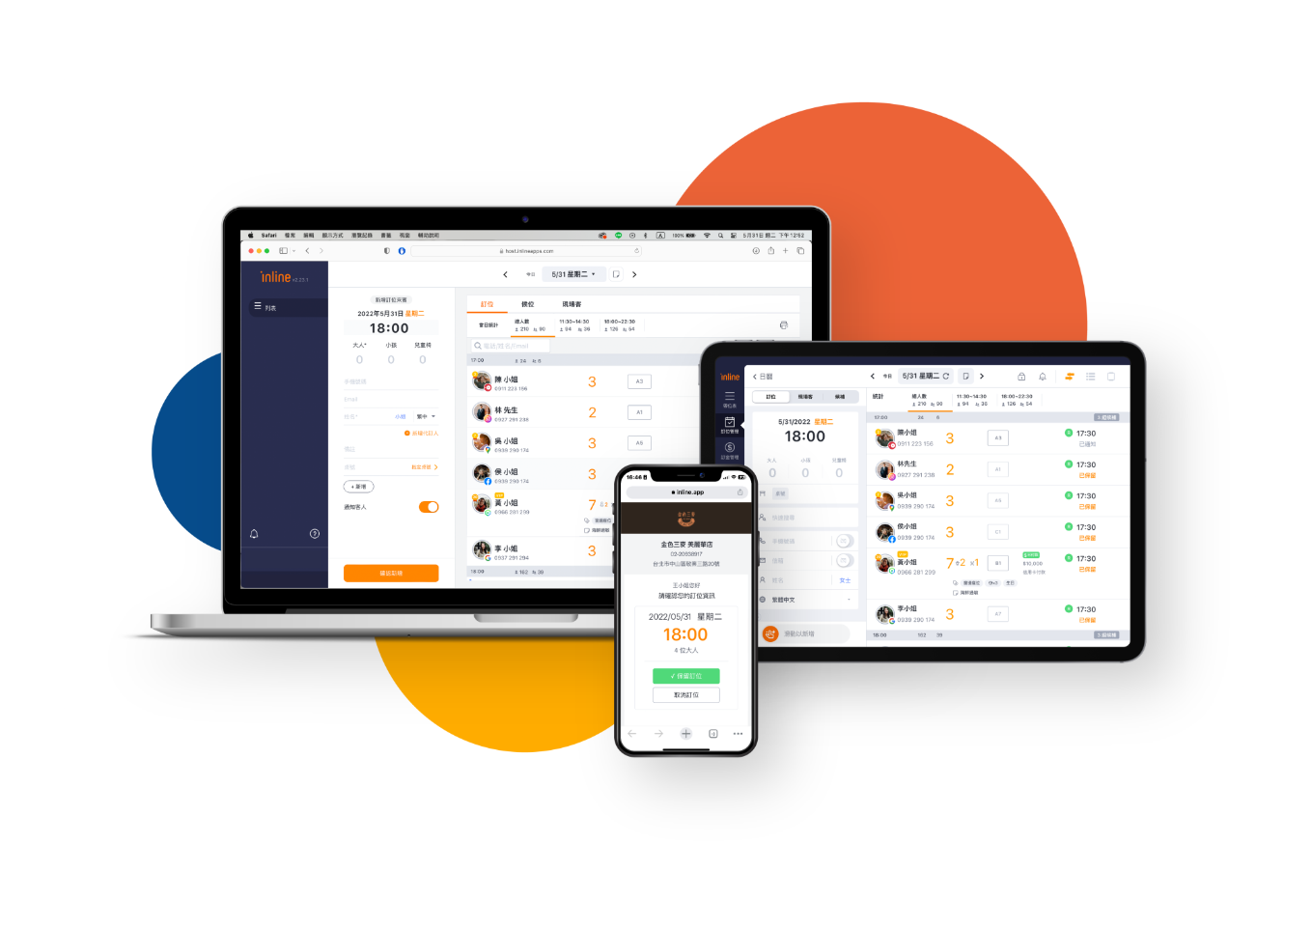
Related Website Comparison - Inline
What we like about Inline:
Excellent automation (SMS confirmations).
Visual queue management.
Notes:
For our research, we looked at Inline, the popular restaurant booking app. We really liked their automation features, like SMS confirmations and visual queue management. However, we realized we couldn't just copy them.

Slide 10
Related Website Comparison - Inline
 | Inline | BackSpace
Target Audience | Restaurant owners, general diners | Club members, students
Core Focus | Turnover, Payment, Queuing | Identity Verification, Conflict-free
Allocation Logic | Table-based configuration | Time-slot based, Strict anti-overlap
Feature | Ordering, Waitlist, Payment | Space/Asset Mgmt, Permission Control
Notes:
Here is why BackSpace is different from Inline:
Target Audience: Inline is for restaurants and diners. We are for Students and Clubs.
Core Focus: Inline cares about turnover rates and payments. We care about Identity Verification and ensuring Zero Conflicts.
The Key Difference (Allocation Logic): Inline is Space-centric—it manages tables and allows table sharing. BackSpace is Time-centric. In a university, we must strictly prevent time overlaps. You can't share a lecture hall podium at the same time."

Slide 11
Creative Feature: Permission System
The Math:
Read (4): View schedules.
Write (2): Make reservations.
Admin (1): Approve requests/Manage users.
Implementation:
Guest: Level 4
(Read-only)
Club Member: Level 6
(4+2, Read + Write)
Super User: Level 7
(4+2+1, Full Access)
Notes:
One of our creative technical highlights is our Permission System. Instead of creating multiple columns in the database for permissions, we used Bitwise Math:
Read is 4.
Write is 2.
Admin is 1.
By adding these together, we create 'Permission Masks'. For example, a Club Member is Level 6 (4+2), meaning they can Read and Write. A Super Admin is Level 7. This makes our database checks incredibly fast and efficient

Slide 12
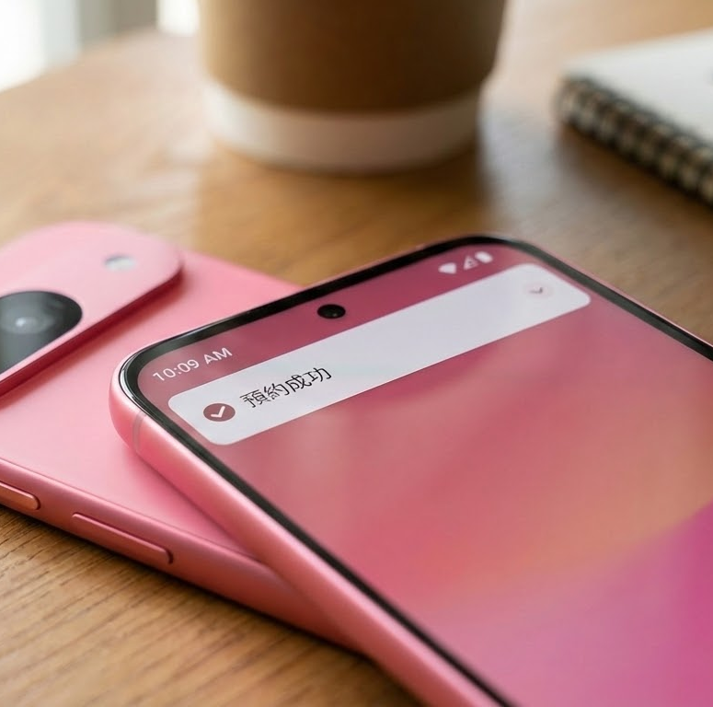
Future Outlook
Notification System
(Discord Bot / Discord Webhook)
Notes:
Looking ahead, we plan to implement a Notification System. We want to integrate Discord Webhooks so users get an instant message saying 'Reservation Successful' when approved.

Slide 13
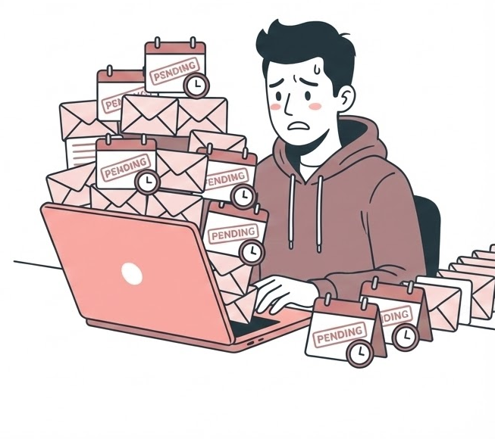
Limitations
Approval Bottleneck:
The system currently relies on manual admin approval. If admins are inactive, requests remain pending.
Notes:
However, we do have limitations. Currently, there is an Approval Bottleneck. The system relies on manual admin approval. If the admin is inactive, requests stay 'Pending' indefinitely. We hope to automate this in the future.

Slide 14
Source Code & Docs
https://github.com/kevinlee-06/webfinal10
Notes:
Our full source code and documentation are available on GitHub. Thank you for listening.

Slide 15
Tour
https://final.ntut.uk

Slide 16
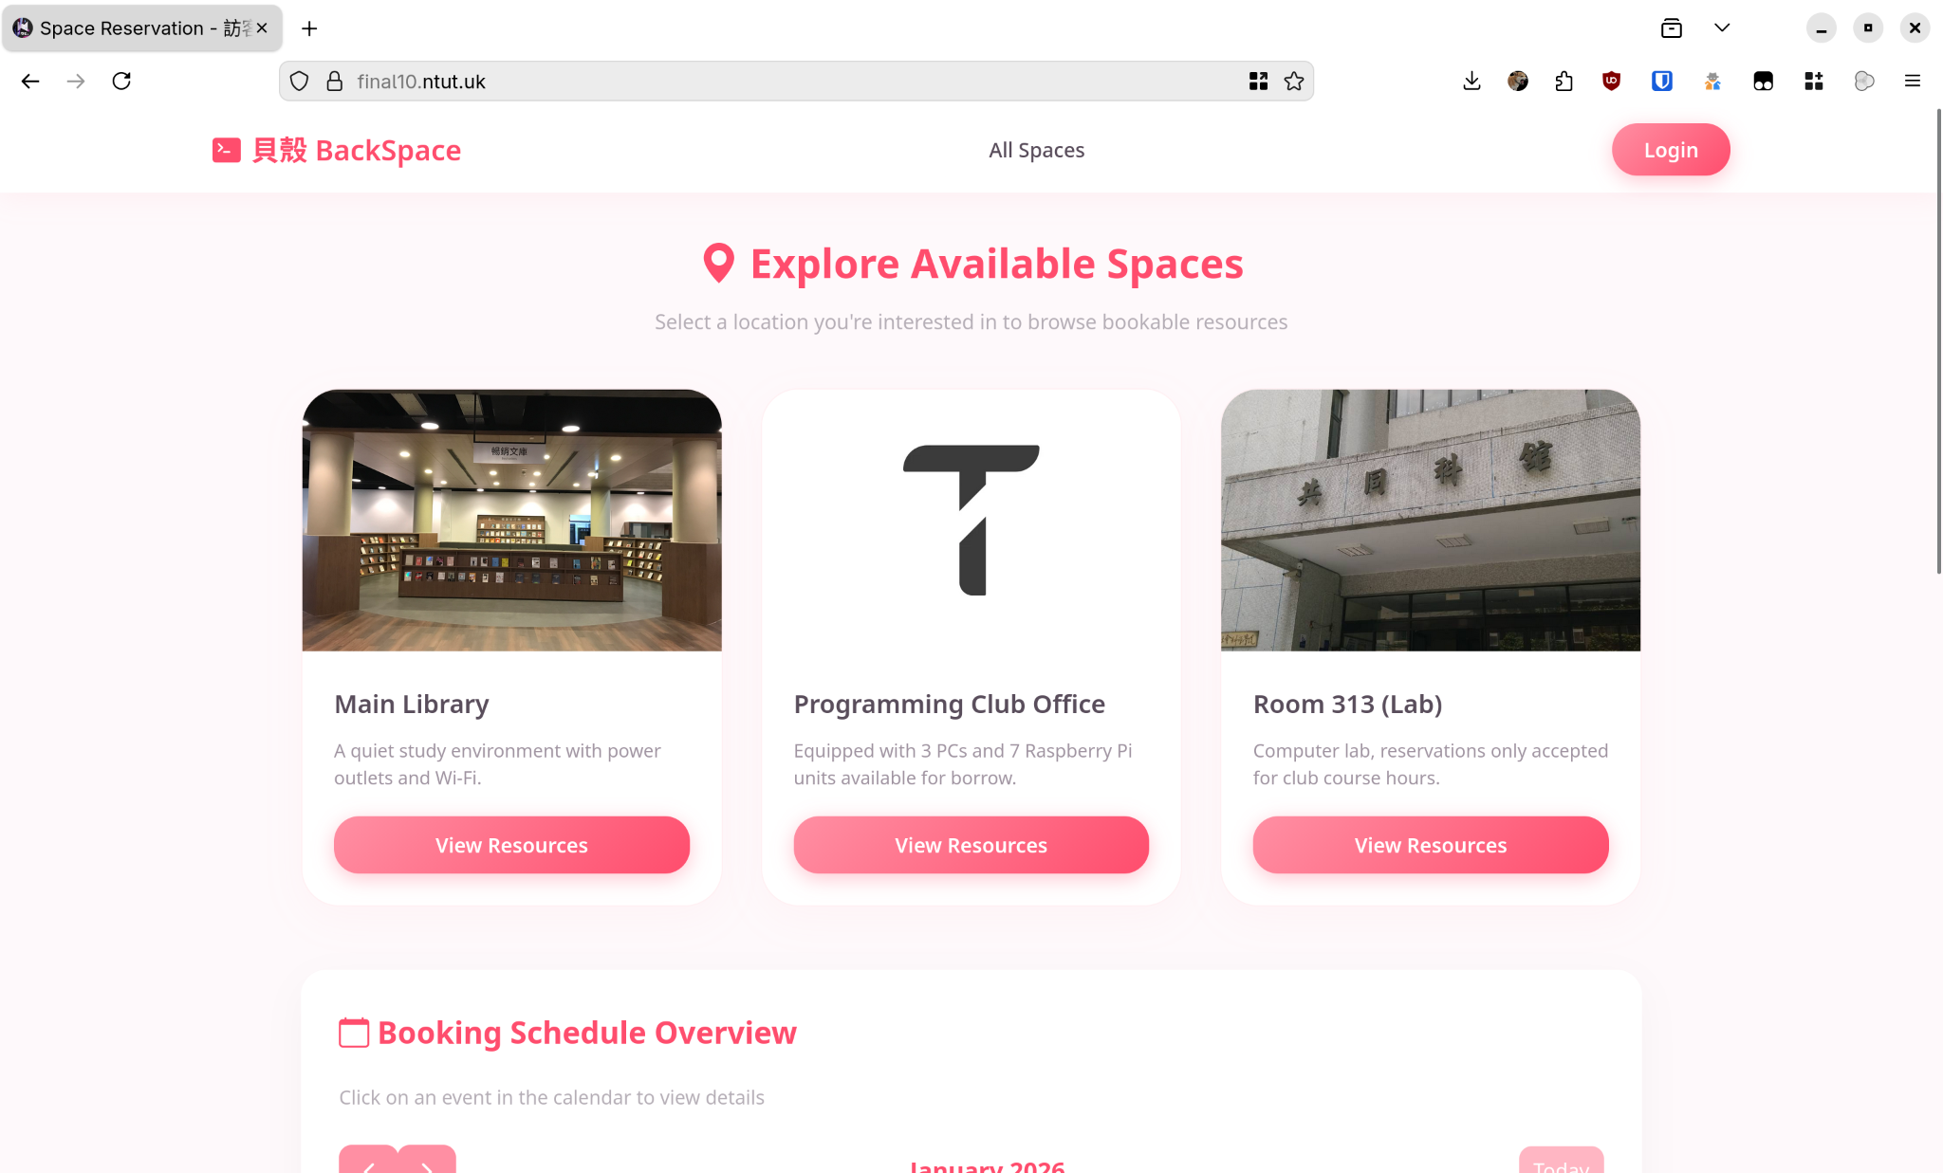
Landing Page
The entry point for all users, displaying a card-based list of available facilities like the Main Library, Club Office, and Computer Labs.
Notes:
"Let's start at the beginning. This is our Landing Page. We prioritized a clean, visual 'Card Layout' so students can immediately see what spaces are available. Whether it's the Main Library for studying or the Programming Club Office for group work, everything is accessible at a glance."

Slide 17
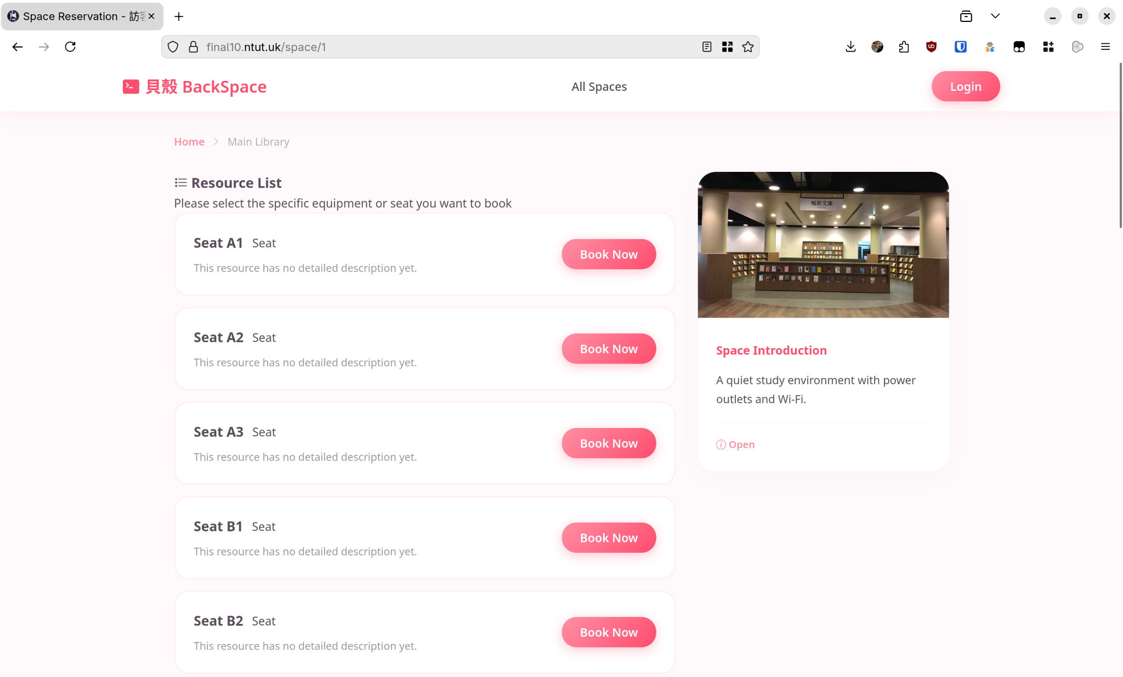
Resource & Equipment List
A detailed view that appears after clicking a space, allowing users to book specific seats or assets (e.g., Seat A1, Seat A2).
Notes:
"We don't just book rooms; we book resources. When a user clicks on 'Main Library', they see this detailed list. This allows for granular control—students can reserve specific seats, like Seat A1, ensuring they get exactly the spot or equipment they need."

Slide 18
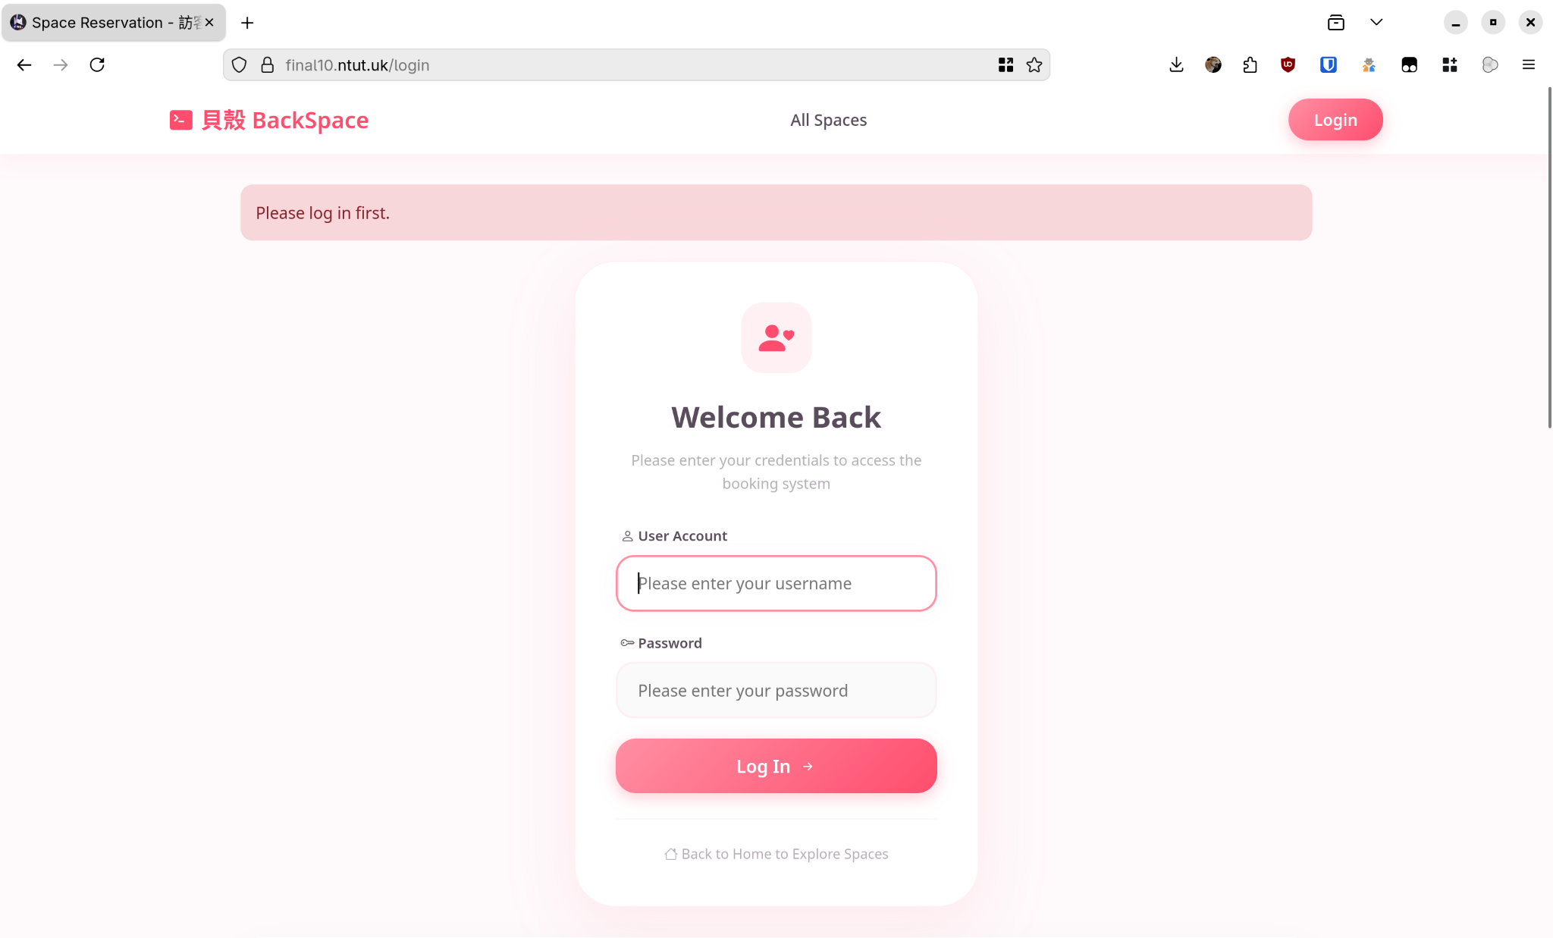
Login Portal
The secure gateway that requires valid credentials, distinguishing between standard users (students) and administrators.
Notes:
"Security is a core feature, not an afterthought. Before any reservation is made, users must authenticate. This links every booking to a valid student ID, preventing anonymous spam and ensuring accountability for the space."

Slide 19
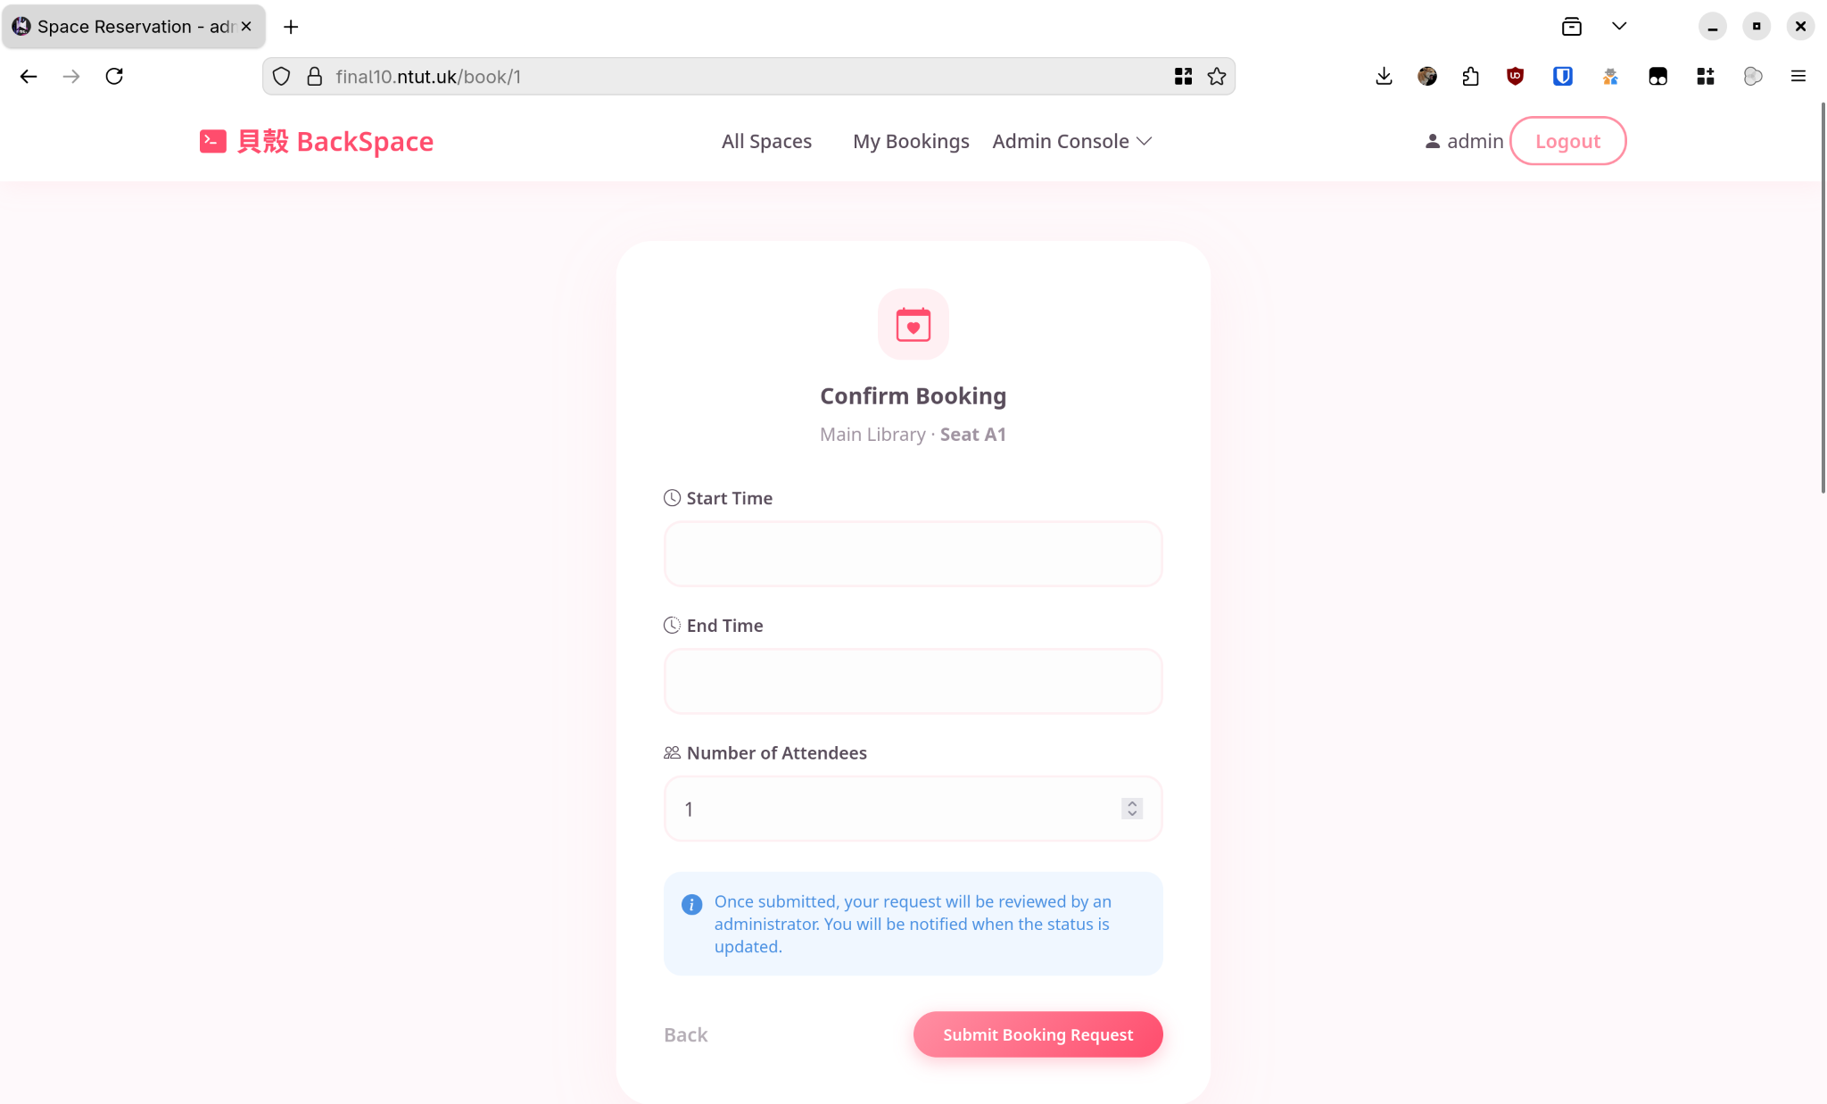
Booking Request Form
The interface where users define their "Time Slot" and attendee count. This is where the overlap-check logic happens.
Notes:
"This is where the magic happens. A user selects their start and end time here. In the background, our PostgreSQL database runs an immediate check. If these times overlap even by a second with an existing booking, the system blocks it right here."

Slide 20
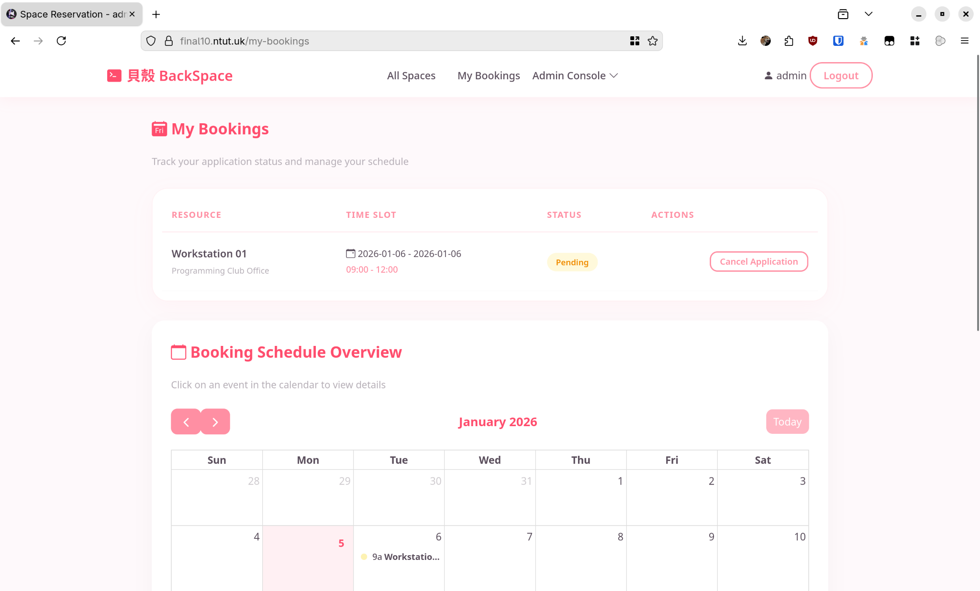
My Bookings
A personal dashboard for students to view their schedule and the status of their requests (Pending vs. Approved).
Notes:
"After submitting, the student is taken to their dashboard. They can see their request is currently 'Pending' (highlighted in yellow). This transparency stops students from wondering if their request was received."

Slide 21
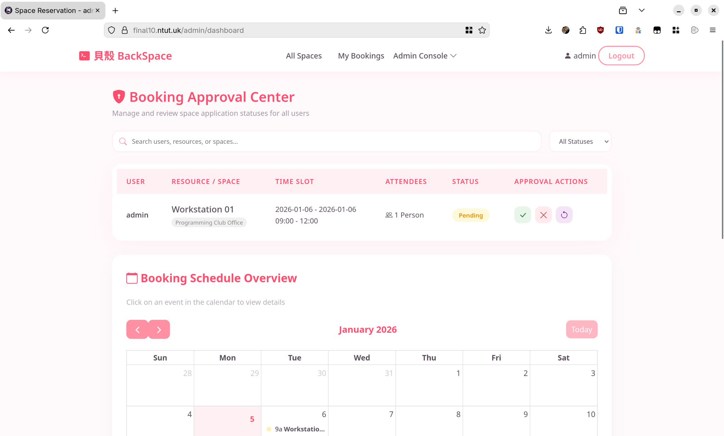
Admin Console - Approval Center
The command center for club leaders to review incoming requests and take action (Approve/Reject).
Notes:
"Now, let's switch hats to the Administrator View. This is what a club president sees: a clear list of incoming requests. With one click on the green checkmark, they can approve a booking, which updates the database instantly."

Slide 22
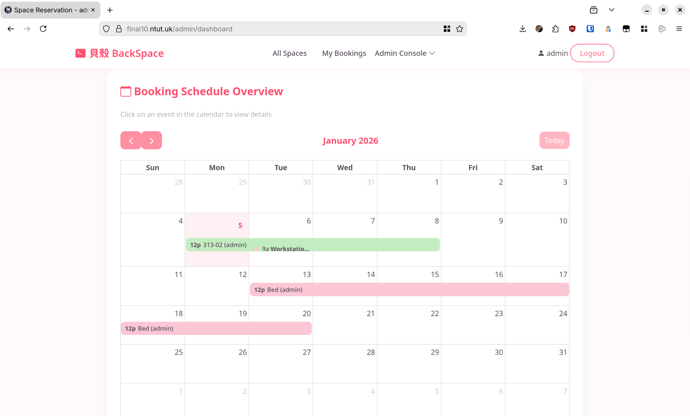
Global Calendar Overview
A high-level calendar view for admins to visualize usage across the entire month and spot busy periods.
Notes:
"For a bird's-eye view, Admins have this Global Schedule. It visualizes all reservations across the campus. This helps administrators spot peak usage times or potential maintenance windows without digging through tables."

Slide 23
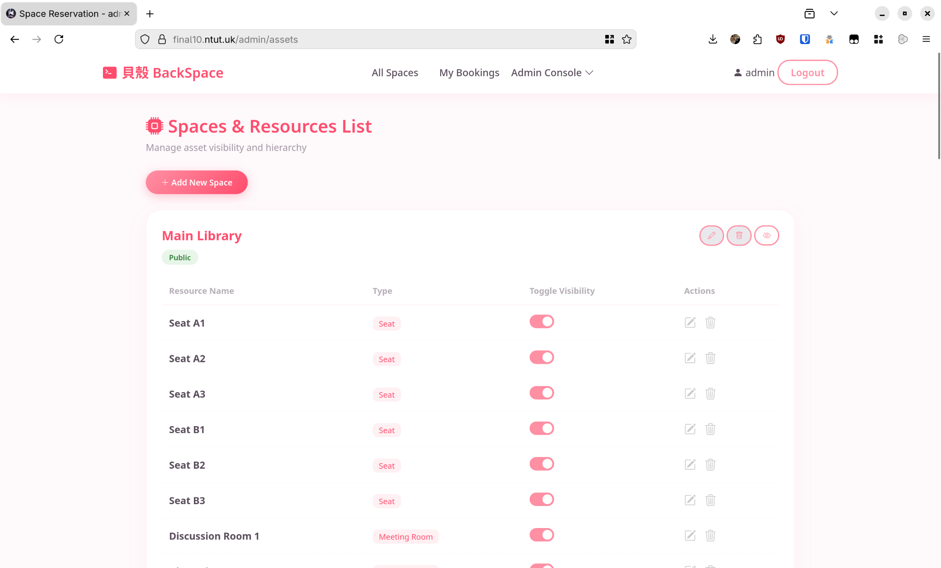
Spaces & Resources Management
The CRUD interface for admins to add new rooms or toggle the availability of existing seats without coding.
Notes:
"The system is built to be dynamic. If the library adds a new seat or a computer breaks down, the Admin can toggle availability or add new resources right here—no code updates required."

Slide 24
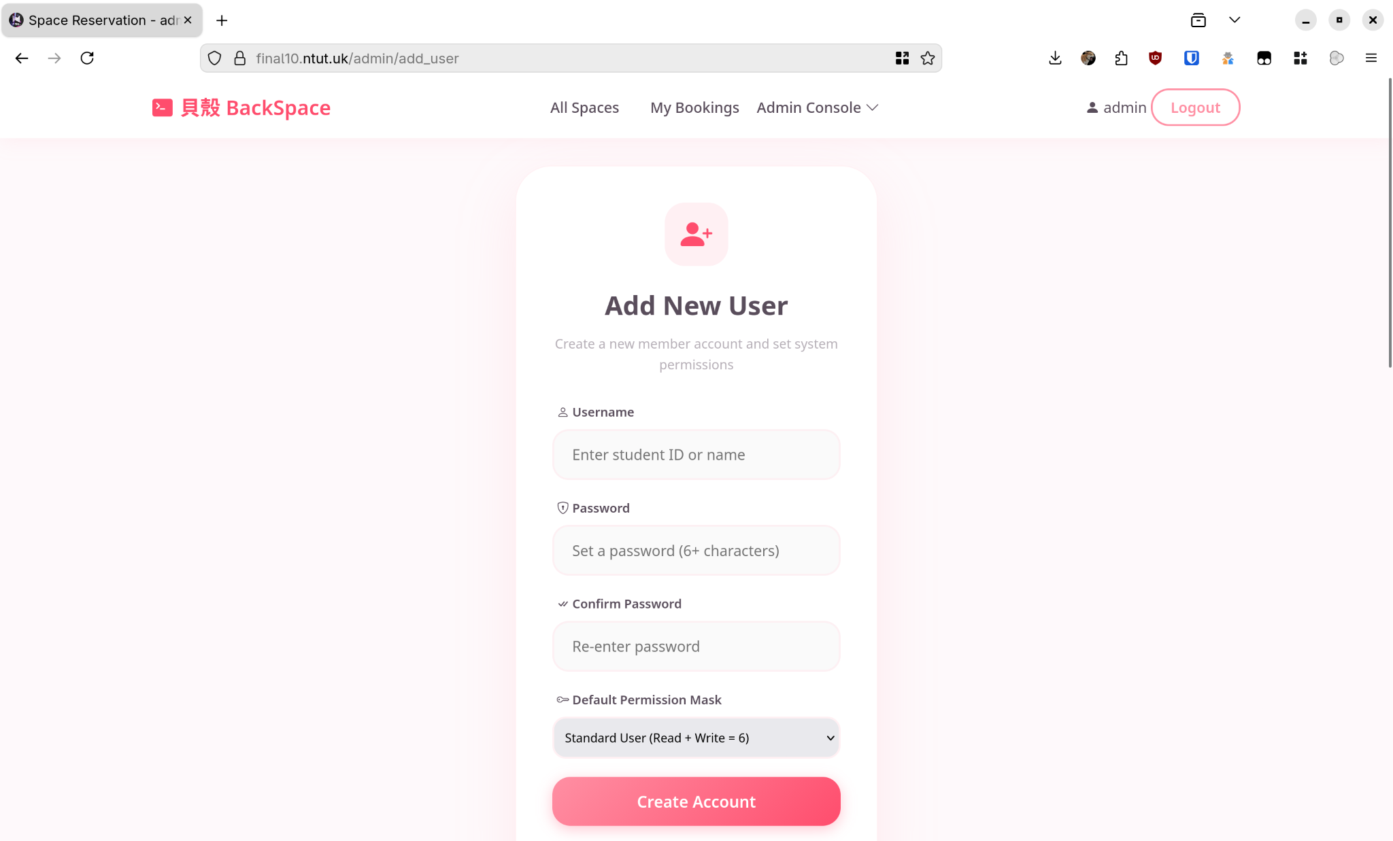
Add User & Permissions
The interface for creating accounts and assigning permission masks (our Bitwise system).
Notes:
"Finally, this is our User Management screen. This is where we apply our Bitwise Permission System. When creating a user, we assign a permission mask—like 'Standard User'—which mathematically determines what features they can access."

